Slide 1
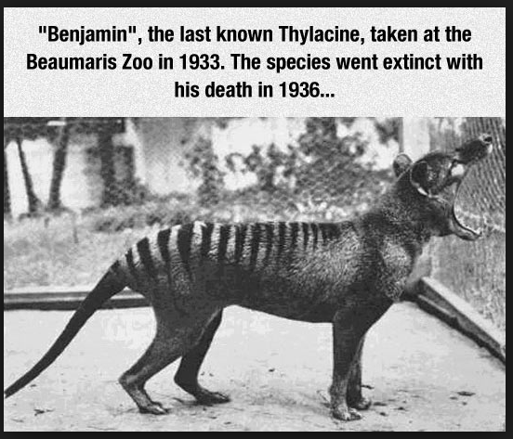
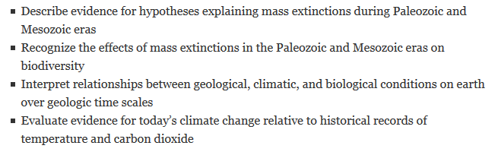
Copyright 2003, the New Yorker Magazine

Slide 2
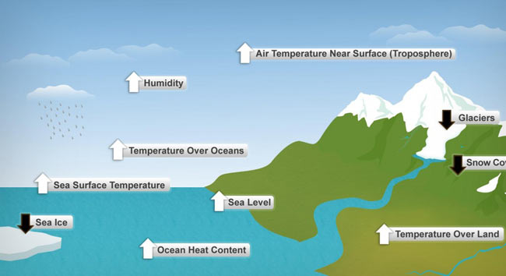
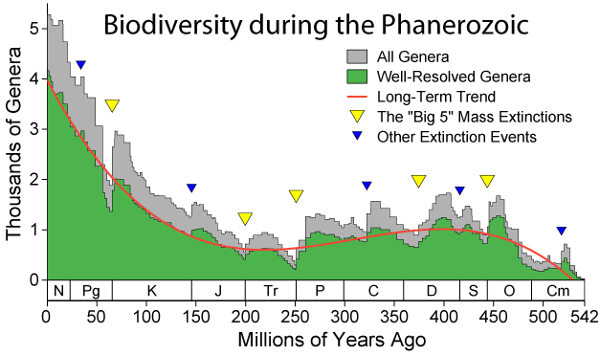
Extinctions and Climate Variability
“Of all species that have existed on Earth, 99.9% are now extinct. Many of them perished in five cataclysmic events.”
10 Indicators of a Warming World
Notes:
Quote from http://www.pbs.org/wgbh/evolution/extinction/massext/index.html

Slide 3
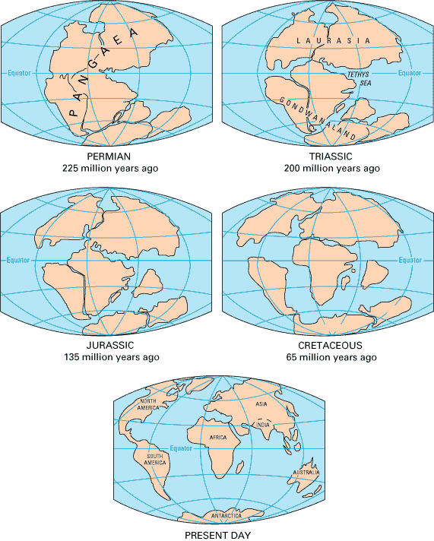

Slide 4
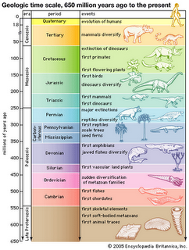

Slide 5
How do you define “Mass Extinction”?
Any substantial increase in the amount of extinction (ie. lineage termination) suffered by more than one geographically widespread higher taxon during a relatively short interval of geologic time, resulting in at least temporary decline of standing diversity. (from Sepkoski, 1986)
99.9% OF ALL SPECIES THAT HAVE EVER LIVED ARE NOW EXTINCT.
Notes:
Key components of first definition: many taxa, higher taxa, geographically widespread, short interval, decline of diversity.
How short is catastrophic? According to Knoll (1984), a catastrophe is a biospheric perturbation that appears instantaneous when viewed at the level of resolution provided by geological record. In many records, it is unlikely that one can distinguish an episode of extinction lasting 100 years from one lasting 100,000 years.
How large must the geographic area be? Raup (1992)- half Earth’s surface needs to be environmentally affected to produce extinctions at magnitudes seen in the fossil record.

Slide 6
Mass Extinctions
Cretaceous-Tertiary Extinction (65). **Dinos**
End Triassic Extinction (200).
Permian Triassic Extinction (250). **Greatest**
Late Devonian Extinction (364).
Ordovician-Silurian Extinction (440).
(#= millions of years ago)

Slide 7
Cretaceous-Tertiary Extinction (65)
This is also known as the K/T extinction.
About 85% of all species disappeared, in particular the dinosaurs.
Organisms that went extinct include more than half of all marine species and many terrestrial plants and animals, including all dinosaurs
Some species including crocodiles, turtles, lizards, mammals, and birds made it through with little effect.
Opened niches for the dominance of mammals in the Cenozoic (adaptive radiation)
Meteor impact seems to be the most probable cause.

Slide 8
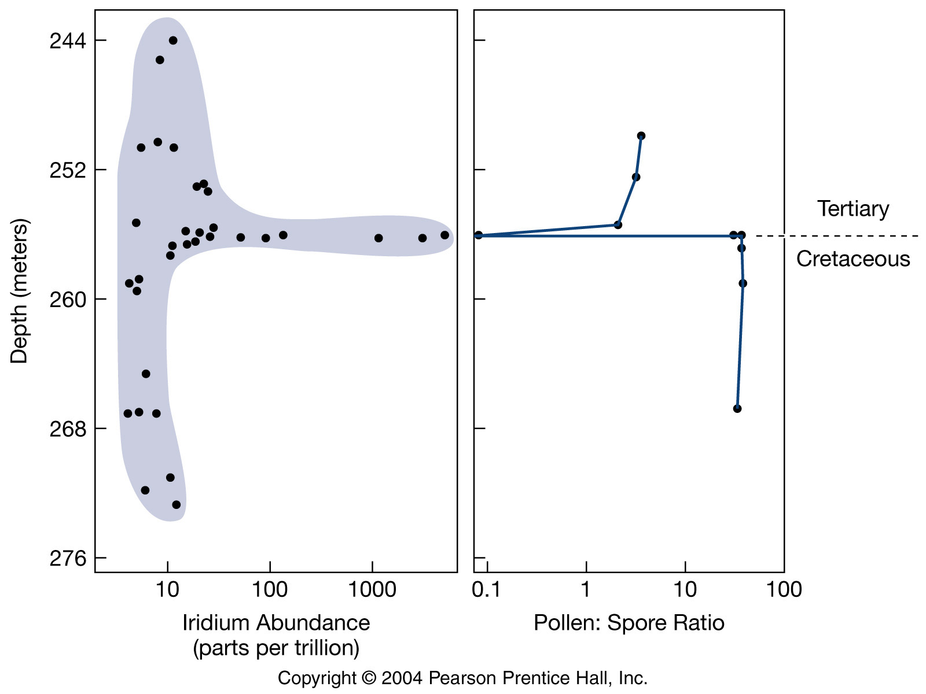
Plants as well as animals should have suffered as a result of the meteorite impact. There is evidence of a significant turnover in the types of vegetation inhabiting the land surface. Much of this work is based on the spore and pollen record.

Slide 9
End Triassic Extinction (200)
This is one of the less significant extinctions.
About one quarter of all species disappeared about 208 million years ago.
Happened in less than 10,000 years!
Opened door for the dominance of dinosaurs in the Jurassic.
At least two extinctions were involved.
Climate change seems to have been the major factor.
Including many therapsids (synapsid ancestors of mammals), all large non-dinosaur archosaurs (ancestors of crocodiles and alligators), & most large amphibians.
Causes largely unknown. Possibly a large meteorite that crashed into what is now Quebec may have been responsible.

Slide 10
Permian Triassic Extinction (250)
The largest extinction to ever occur As many as 96% of all marine species and 3/4 of all land species were lost.
Several causes have been proposed, including sea level change, volcanic activity, and an asteroid collision.
The most important factor seems to be cilmate change.

Slide 11
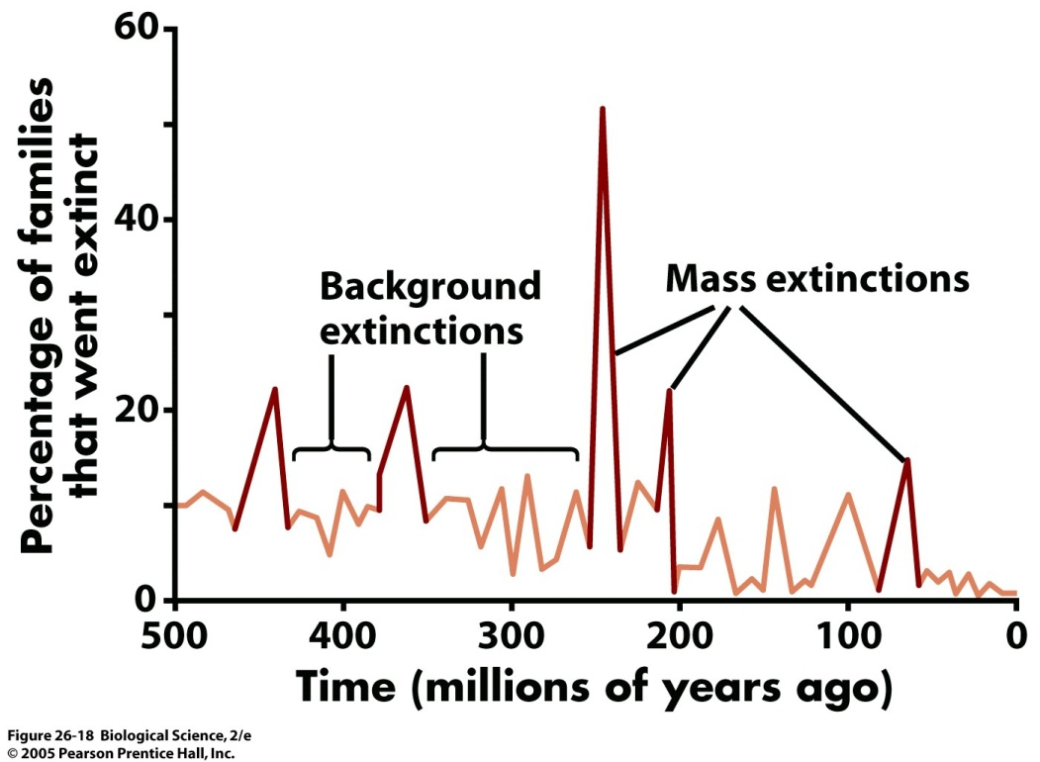
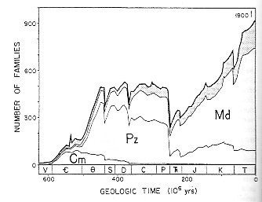
The demise of Paleozoic life (end Permian)
Extinctions among diapsids and synapsids
Many seedless plant lineages disappear

Slide 12
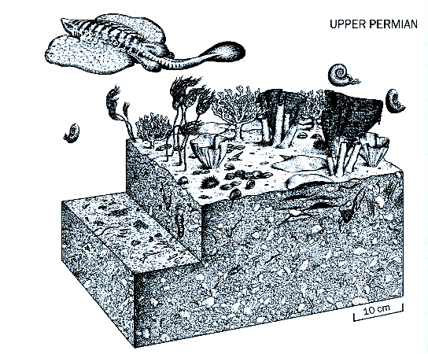
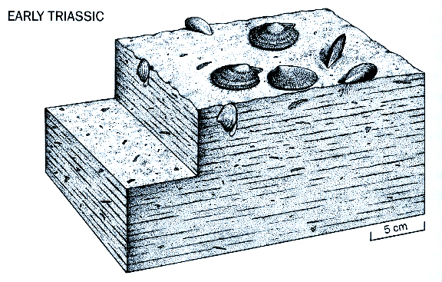
Before and After

Slide 13
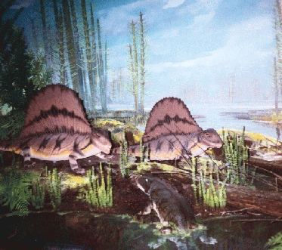
The “Great Dying”
Approx. 70% of all terrestrial organisms
Many groups of amphibians
Therapsid “mammal-like” reptiles
Includes Pelycosaurs
Forests!

Slide 14
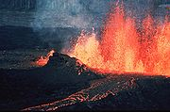
Hypotheses for the End-Permian Extinction
Rapid climate change as Pangaea formed
Extreme periods of volcanism
Anoxic oceans and hydrogen sulfide
High temps, CO₂, nutrient runoff
Left: Campbell & Reece 25.15. Right: http://en.wikipedia.org/wiki/Volcano

Slide 15
Is anybody happy about this?
Survivors and Lazarus taxa
Ecological opportunity: jobs to fill!
Adaptive radiation
Beginnings of modern-appearing marine communities
Niches vacated by amphibians are filled by reptiles
Reptiles are better adapted to dry climates
Enter the dinosaurs

Slide 16
Late Devonian Extinction (364)
This extinction took place about 365 million years ago.
Scientists think it occurred over a period of about 3 million years.
About 70% of all species vanished.
Scientists are not in agreement with the reasons, but many think it had to do with climate change, as many of the species lost were warm water species.

Slide 17
Ordovician-Silurian Extinction (440)
This extinction occurred about 440 million years ago.
The cause is thought to have been an ice age that resulted in tying up much of the water in ice sheets.
Many species lost up to 50% of their members.
Scientists think that this extinction occurred in two phases.

Slide 18
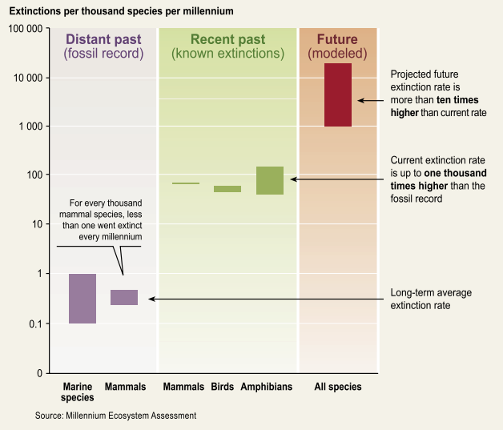
Is the sixth mass extinction underway?

Slide 19
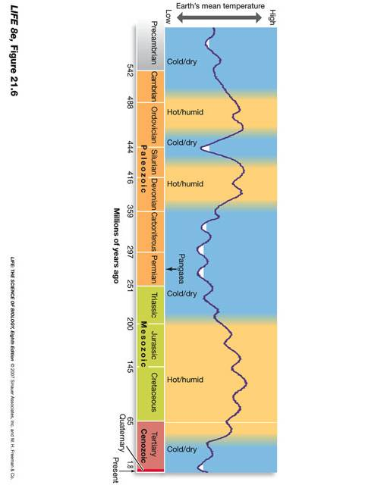
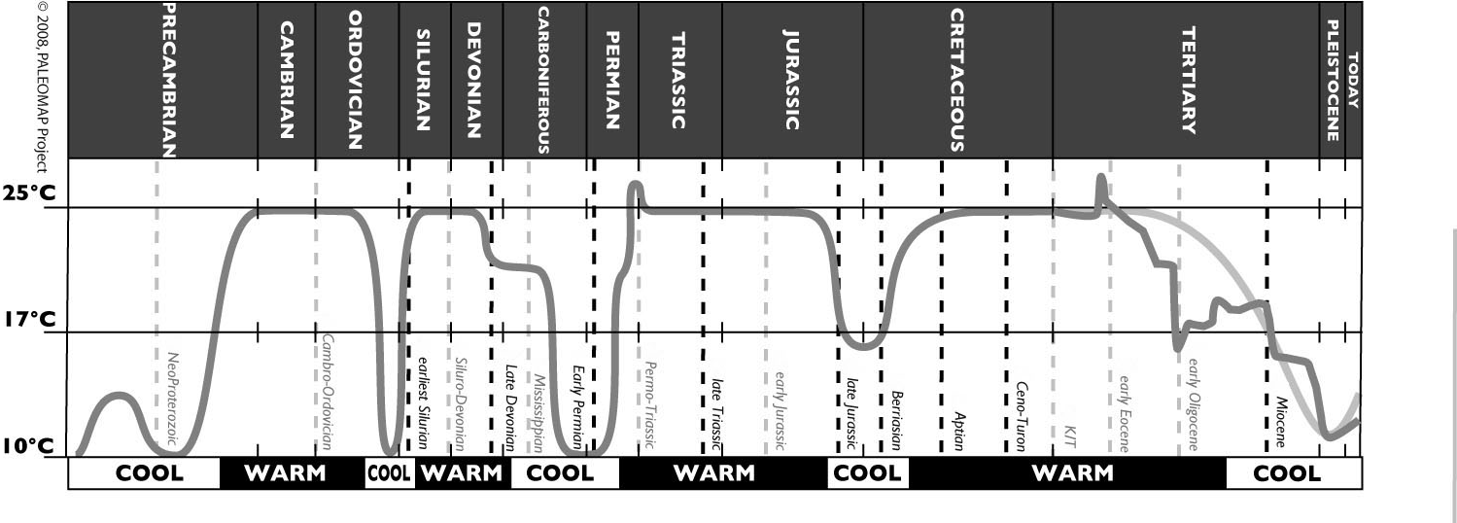
Long-term climatic regimes
Mass extinctions:
http://scotese.com/climate.htm
Notes:
Global temp ~14.5dC, CO2now.org

Slide 20
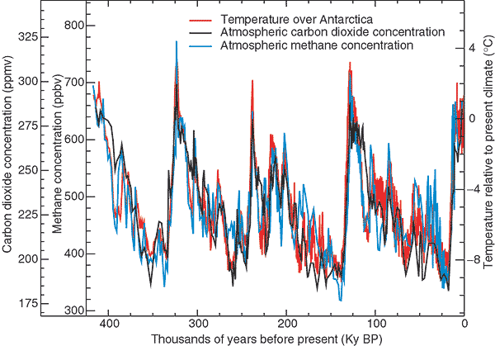
Antarctic Ice Core Record
TODAY – 403.5 ppm
Climate Change 2001, Fig 2.2: Variations of T, CH₄, and CO₂ concentrations derived from air trapped within ice cores from Antarctica.
http://www.grida.no/climate/ipcc_tar/wg1/fig2-22.htm
Notes:
Co2now.org (today’s level)
Projections for 2050: 425-550 ppm, 2100: 550-1000 ppm (http://www.ipcc-data.org/ddc_co2.html)
Current global average temperature is 14dC
Jan 2012: 390 ppm
Aug 2013: 397 ppm

Slide 21
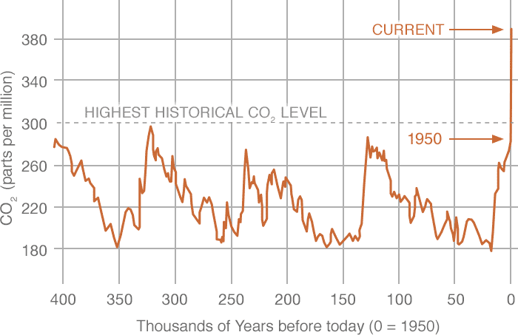
Data source: Reconstruction from ice cores. Credit: NOAA
Notes:
http://climate.nasa.gov/vital-signs/carbon-dioxide/

Slide 22
Resources for more
http://media.hhmi.org/biointeractive/click/extinctions/
http://www.pbs.org/wgbh/evolution/extinction/dinosaurs/index.html
http://media.hhmi.org/biointeractive/click/paleoclimate/
http://media.hhmi.org/biointeractive/posters/Biointeractive_Forams.jpg
http://www.nova.org.au/earth-environment/climate-change-and-biodiversity
http://www.theguardian.com/environment/climate-consensus-97-per-cent/2015/oct/13/methane-release-from-melting-permafrost-could-trigger-dangerous-global-warming

